Slide 1

How to Educate yourself on your Teacher Retirement Plan

Slide 2

Hybrid Retirement Benefit
The Employees’ Retirement System of Rhode Island was established in 1936 to provide retirement benefits to all public sector employees
We manage retirement plans and administer benefits for over 60,000 active members, inactive members, retirees, and pension beneficiaries:
State Employees
Public School Teachers
Municipal Employees' Retirement System (the municipal retirement plan covering participating cities and towns)
Municipal Police and Fire Departments
Judicial Retirement Plan
State Police Retirement Plan

Slide 3

Mandatory Contributions
Since July 1, 2012 Employees have paid into a hybrid retirement plan, made up of both a Defined Benefit/Pension (DB Plan) and a Defined Contribution/401(a) (DC Plan).
The money you put into the DC Plan is an entirely separate pool of money from what you pay into your pension.
All new employees immediately begin making mandatory contributions to this plan as long as they work 20 or more hours per week.
Contributions come out of your biweekly paycheck
All contributions remain within the plan while you are employed under ERSRI-covered employment service.
No withdrawals
No loans

Slide 4

Defined Benefit/ Pension Plan

Slide 5

What is a defined benefit/ pension plan?
Your Pension Benefit is managed by ERSRI and pays you a specific amount of money per month when you are eligible to retire.
You contribute towards your individual pension fund.
Your employer contributes into the pension fund for all employees.
The amount of your monthly pension benefit is based on a number of criteria including your schedule, how long you have worked and your salary.
Your pension benefit is not based on the dollar amount you have contributed to the plan – it will last your lifetime. Members use their own contributions when they first retire, then their pension is entirely State funded.

Slide 6
Vesting in the Pension
Employees who contribute to both the pension and 401(a) contribute 3.75% of their salary to the pension and are currently accruing 1%/year
Employees who have stopped contributing to the 401(a) contribute 11% of their salary to the pension and are currently accruing 2%/year
You are eligible to receive a pension after 5 years of contributing service and meeting the required minimum age
You are able to take a refund of your contributions at any time after leaving ERSRI-covered service – this waives your right to a pension
Contributions to the pension do not have any market fluctuation, so you will always be refunded the exact amount you contributed if you choose not to take a pension

Slide 7
What’s a Schedule?
Schedules are determined by when you were hired and how many years of service you had at certain points in time.
Years of Service July 1, 2005
Years of Service September 30, 2009
Years of Service June 30, 2012
Schedule type impacts when you are eligible to retire, your accruals and service credit factor, and what your benefit will be when you retire.

Slide 8
How do we Determine your Schedule? 8 Schedule Types
Schedule TA
Active and eligible to retire with either 28 years of service OR age 60 with 10 years of service on or before 9/30/2009
Schedule TB
Active and eligible to retire with either 29 years and age 59 OR age 65 with 10 years on or before 9/30/2009
Schedule TAB E
Active with at least 10 years as of 7/1/2005. Not eligible to retire as of 9/30/2009. Became eligible to retire on or before 6/30/2012
Schedule TAB NE
Active with at least 10 years as of 7/1/2005. Active as of 10/1/2009, and not eligible to retire on or before 6/30/2012.

Slide 9
How do we Determine your Schedule? 8 Schedule Types
Schedule TB1E
Active but not eligible to retire as of 10/1/2009, but became eligible to retire on or before 6/30/2012
Schedule TB1NE
Active but not eligible to retire as of 9/30/2009 or 6/30/2012, and had at least 5 years as of 6/30/2012
Schedule TB2
Hired on or before 6/30/2012 but did not have at least 5 years as of 6/30/2012.
Schedule TB3
Hired on or after 7/1/2012

Slide 10

How do we Determine Your Pension?

Slide 11
How do we Determine Your Accrual Rate?
For every year you work for a participating employer, you accrue a set percentage that are added together to determine your Service Credit Factor
Accrual Rate per Year
Schedule | Maximum Service Credit Factor
Schedules TA, TAB E and TAB NE | 80%
Schedules TB, TB1E, TB1NE, TB2 and TB3 | 75%

Slide 12
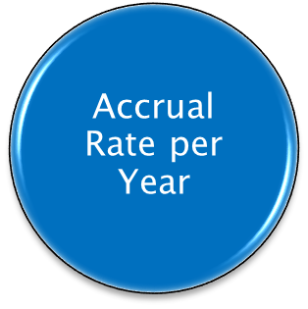
Accrual Rates for State Employees
Year(s) Earned | Schedule TA through 6/30/12; TA/B through 9/30/09 | Schedule TB through 6/30/12; TA/B from 10/1/09-6/30/12 | Accruals as of 7/1/2012 (all members) | Accruals as of 7/1/15 (if 20 or more years at 6/30/2012)
Years 1-10 | 1.7% | 1.6% | 1.0% | n/a
Years 11-20 | 1.9% | 1.8% | 1.0% | n/a
Years 21-25 | 3.0% | 2.0% | 1.0% | 2.0%
Years 26-30 | 3.0% | 2.25% | 1.0% | 2.0%
Years 31-34 | 3.0% | 2.5% | 1.0% | 2.0%
Year 35 | 2.0% | 2.5% | 1.0% | 2.0%
Years 36-37 | n/a | 2.5% | 1.0% | 2.0%
Year 38 | n/a | 2.25% | 1.0% | 2.0%

Slide 13
How do we determine your Final Average Salary?
Schedule | Highest Average Salary
Schedule TA and TB | 3 highest consecutive years
Schedules TAB E, TAB NE, TB1E, TB1NE, TB2, and TB3 | 5 highest consecutive years
Final Average Salary (FAS)

Slide 14
When Can I Retire (Schedule Based)?
Schedules TA, TAB E, TB, and TB1E | Schedule TAB NE | Schedule TB1NE | Schedules TB2 and TB3
Currently eligible to retire. | Social Security Normal Retirement Age (SSNRA) proportionally scaled back based on years of service earned as of 9/30/2009 and 6/30/12 Not less than age 59 5 years of contributory service | Social Security Normal Retirement Age (SSNRA) proportionally scaled back based on years of service earned as of 9/30/2009 and 6/30/12 Not less than age 59 65 if determined by Article 7 calculation 5 years of contributory service at 6/30/12 | Social Security Normal Retirement Age (SSNRA) and 5 years of contributory service

Slide 15
Rule of 95: An alternate way to retire with full earned benefits
Only applies to those whose retirement date is later than age 62
The rule of 95 is only used to provide an EARLIER retirement date than your Schedule Based Retirement Eligibility Date
Members can retire when their age (at least 62 years old) plus their years of service equal 95
Example: Schedule Based Eligibility Age: 67
At age 62 you have 33 years of Service (62+33=95)
Rule of 95 Retirement Date: 62 years old

Slide 16
Retiring Early: Reduced Retirement Benefit
Transition Rule 1
You must have 20+ years of completed service and be within 5 years of your full eligibility service retirement date
Your benefit is reduced by a set percentage for each year you leave before your full-service eligibility
Ex. 1: If you leave 5 years before reaching eligibility you would receive 62% of the benefit earned through your last day of employment
Ex. 2: If you leave 1 year 6 months before your full eligibility date you would receive 87% of the benefit earned through your last day of employment
Year(s) Before Retirement Eligibility | Per Year Reduction | Cumulative Reduction
1 | 9% | 9%
2 | 8% | 17%
3 | 7% | 24%
4 | 7% | 31%
5 | 7% | 38%

Slide 17
Retiring Early: Reduced Retirement Benefit
Transition Rule 2
Eligibility for Transition Rule 2:
How Early Can You Retire?
How is Your Benefit Reduced?
You completed 10 years of service by June 30, 2012.
You can retire based on your eligibility rules in effect as of 10/1/2009.*
ERSRI will use your Service Credit Factor and Highest Average Salary earned as of June 30, 2012 to calculate your pension.
* A minimum age of 62 will be adjusted downward based on the years of service earned as of September 30, 2009.

Slide 18
How is teacher service counted?
Number of School Days Worked in a School Year | Years Worked Prior to November 18, 2011 | Years worked On or After November 18, 2011
180+ | 1.00 Year | Actual Days Worked / 180 maximum of 1 year
135-179 | 1.00 Year
91-134 | 0.75 Year
67-90 | 0.50 Year
45-66 | 0.25 Year
0-44 | No Credit

Slide 19
Managing your account
Register your account online at www.ERSRI.org
Press blue “Active Employee” login
Press blue “Click here to log in to your account” button
First Time Users: Click Self-Registration link to create online account (if no valid e-mail on file with ERSRI, call 401-462-7600, prompt #4)
Forgot Password/Login ID: Click on the link below the login to access your credentials

Slide 20
Managing your account
The site allows you to:
Update phone number and email address
Remember that when you leave service we can’t contact you through your work information!
Review your pension account information
Access ERSRI forms (including beneficiary form for pension and death benefit!)
Click on “TIAA” link to access your 401(a)!

Slide 21
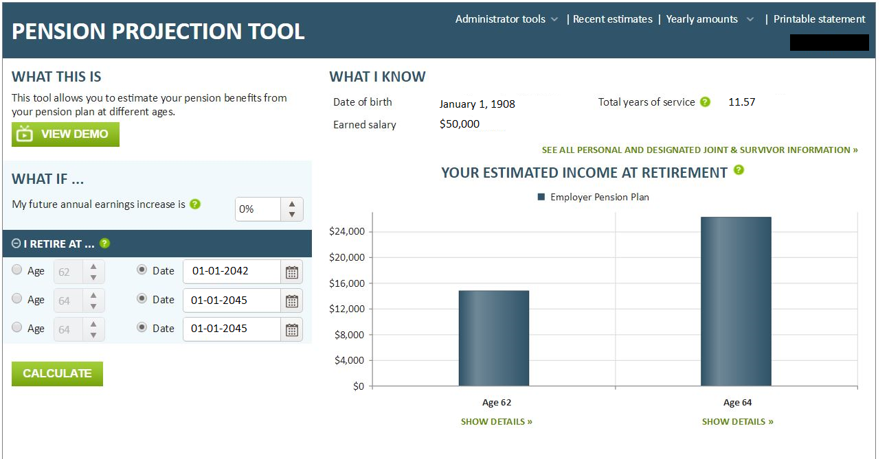
Pension Projection Tool
Access Pension Projection Tool to get retirement eligibility dates and estimated income at retirement!*
*Please note – the figures within the Pension Projection Tool are estimated based on the data reported by your employer. Be sure to read and agree to the disclaimer.

Slide 22
Other benefits through ERSRI
Disability Benefits
For those who qualify and are approved by the ERSRI Board, a member can collect a pension based on a permanent disability or illness if they apply for disability before they terminate employment
Ordinary – injury/illness not based on work within ERSRI-covered employment service
Must be vested with 5 YOS to qualify
Accidental – injury occurred at work or is attributed to work circumstances within ERSRI-covered employment service
Survivor Benefits
Your pension could continue for a survivor if you choose that option upon retirement
If you die after vesting in the system but before you begin collecting a pension, a designated beneficiary could receive a pension or a refund of your contributions

Slide 23
Death Benefits
What benefits are your survivors entitled to?
A member’s designated beneficiary is eligible to receive a one-time death benefit payment regardless of retirement option selected.
Benefit is $800 per year of completed service, up to a maximum benefit of $16,000 with 20 years of service.
Benefit reduces 25% each year of retirement to a minimum death benefit of $4,000.
If you leave service but do not immediately collect a pension, you waive this benefit
Please be sure to keep your beneficiary information up to date with ERSRI.

Slide 24
Teachers Survivors’ Benefits Only for teachers who do not pay into Social Security
What are Teachers Survivors’ Benefits (TSB)?
TSB provides a lifetime monthly benefit to qualified survivors upon the death of the member.
Which School Districts Participate in TSB?
School districts that do not participate in Social Security offer TSB.
Barrington, Bristol-Warren, Burrillville, Central Falls, Coventry, Cranston, Cumberland, East Greenwich, East Providence, Foster, Glocester, Johnston, Lincoln, Little Compton, Middletown, Newport, North Smithfield, Portsmouth, Scituate, Smithfield, Tiverton, and Westerly.
How Much do You Contribute to TSB?
Teacher Contributions = $115.00 per year (or 1% of salary if less than $115.00).
How Long until You Vest in TSB?
Teachers must make TSB contributions for 6 consecutive calendar months prior to his or her death or retirement in order to qualify for a TSB benefit.

Slide 25

401(a) Plan – Defined Contribution Plan

Slide 26

What is a defined contribution (401a) plan?
The Defined Contribution (DC Plan) allows you to save money for your retirement in a tax-deferred account.
You and your employer contribute a percentage of your salary each pay period into your DC plan that is managed by TIAA.
TIAA manages your investments and when you retire you will withdraw money from this account to pay for your living expenses.
This plan does not pay a specific benefit amount upon retirement – the funds will not necessarily last for your lifetime but are instead used at your discretion.

Slide 27
Participation
Employees who had 20+ years of service with the State on June 30, 2012 stopped contributing to the 401(a) on June 30, 2015
Contributions made from July 1, 2012-June 30, 2015 are owned by the member, but must stay in the 401(a) until the employee terminates employment

Slide 28
Vesting in the 401(a)
Teachers contribute 5% of their pre-tax pay to the 401(a) (7% if not in Social Security)
Vesting in these contributions is immediate, meaning that whenever you leave employment you can utilize these funds.
The city/town contributes to each members 401(a) based on Years of Service at June 30, 2012:
Less than 10 YOS – 1%* of pre-tax pay
10 but less than 15 YOS – 1.25%* of pre-tax pay
15 but less than 20 YOS – 1.5%* of pre-tax pay
* Increase by 2% if not in Social Security
The City/Town contributions vest after 3 years, meaning if you leave service before you have worked for three years, you forfeit these contributions.

Slide 29
401(a) Investment
Your contributions are immediately invested in a Target Date retirement fund, which projects the approximate date you will turn 65 and puts you in a fund based on that year
Younger members are invested in more aggressive options (ie, stocks and equities); as the member gets closer to retirement age investments become more conservative (ie, bonds, money markets)
The account becomes more conservative without the member having to actively make changes
Members can move their investments out of the Target Date funds at any time to other options within the 401(a) plan.

Slide 30
Managing your account
Register your account online at TIAA.org/ri
With Single Sign-on, once you have set up your account with TIAA you can login to your pension account, link on the TIAA icon, and get immediately to your 401(a) without having to sign into both.
The site allows you to:
Review and update your personal information
Check account balances and confirm contributions
Update your beneficiary designation – it needs to be changed separately from your Pension Plan
Change the investment of future contributions
Transfer assets among plan investment options
Choose eDelivery

Slide 31
Leaving State service
When you sever employment, you have options with your account balance:
Leave it in the Defined Contribution Retirement Plan
Roll it to your new employer’s retirement plan or to an IRA
Retirees can begin systematic withdrawals for income
Request a full cash withdrawal
You should not take contributions from a retirement account before you are eligible to retire!

Slide 32
Financial Advice/ Planning
Investment advice in person, via phone
or online
To schedule your session,
call John Cislo at 401-276-3746
or e-mail John.Cislo@tiaa.org.
Or, call 800-897-1026, weekdays, 8 a.m. to 10 p.m. or Saturdays, 9 a.m. to 6 p.m. (ET).
Online Advice and Education at TIAA.org/ri
4 simple steps to directly address your goals and financial situation
Quickly update your account

Slide 33
Retirement Planning Checklist
One or More Years Before Retirement
Log into your account at ERSRI.org to update personal information and run a benefit estimate. If you question any information, reach out to ERSRI for a Salary Verification Form
Contact TIAA to meet with a financial planner to discuss your withdrawal options for your DC plan
Six to Nine Months Before Retirement
Contact ERSRI to schedule an appointment for a group retirement workshop
You will receive your benefit estimate and all paperwork necessary to retire

Slide 34
Retirement Planning Checklist
Two to Three Months Before Retirement
Notify your employer of your intention to retire and provide them with the Employers’ Certification of Retirement form, which you will receive at your ERSRI Retirement Workshop. This form must be completed and returned to ERSRI by your employer. ERSRI cannot begin processing your pension benefit until we receive this form. Please make sure your employer returns the form to ERSRI when you terminate employment
Prior to Your Termination Date
Review the “How to Complete Your Retirement Paperwork; contact ERSRI with questions
Complete and return the Required Retirement Paperwork to ERSRI prior to terminating employment.

Slide 35

Consider saving more
Your school offers one or more Deferred Compensation Plans to save additional money for retirement
Convenient payroll deductions
Pretax savings reduce your current taxable income
Tax-deferred growth on your earnings
Voluntary contributions help bolster your retirement savings
https://www.omni403b.com/PlanDetail

Slide 36

Financial Wellness
To help improve your financial wellness, the State offers the following resources—ranging from in-person fairs and workshops to online tools—all at no additional cost to you:
ALEX® on Financial Wellness

Slide 37

Important Contact Information
Employees’ Retirement System of Rhode Island (ERSRI)
50 Service Avenue, 2nd Floor, Warwick, RI 02886
(401) 462-7600
www.ersri.org
TIAA - DC Plan Coordinator
The Gateway Center
15 Park Row West, Suite 102
Providence, RI 02903
(800) 897-1026
www.tiaa.org/ri
Federal Social Security
Providence Office
(877) 402-0808
www.ssa.gov

