Slide 1

How to Educate yourself on your Retirement Plan

Slide 2
Defined Benefit/ Pension Plan

Slide 3
What is a defined benefit/ pension plan?
Your Pension Benefit is managed by ERSRI and pays you a specific amount of money per month when you are eligible to retire.
You contribute towards your individual pension.
Your employer contributes into the pension fund for all employees.
The amount of your monthly pension benefit is based on a number of criteria including your schedule, how long you have worked and your salary.

Slide 4
Vesting in the Pension
Employees who contribute to both the pension and 401(a) contribute 2% of their salary to the pension (due to the fact that they receive a COLA) and are currently accruing 1%/year
Employees who have stopped contributing to the 401(a) 9.25% (due to COLA) of their salary to the pension and are currently accruing 2%/year
You are eligible to receive a pension after 5 years of contributing service
You are able to take a refund of your contributions at any time after leaving municipal service
Contributions to the pension do not have any market fluctuation, so you will always be refunded the exact amount you contributed if you choose not to take a pension

Slide 5
What’s a Schedule?
Schedules are determined by when you were hired and how many years of service you had at a certain point in time.
Hired before or after June 30, 2012?
Eligible to retire as of June 30, 2012?
Years of Service June 30, 2012?
Schedule type impacts when you are eligible to retire, your accruals and service credit factor, and what your benefit will be when you retire.

Slide 6
How do we Determine your Schedule? *All years must be contributing service to be counted towards retirement eligibility*
Schedule 1
Active and eligible to retire with either 30 years of service OR age 58 with 10 years of service on or before 6/30/2012
Schedule 2
Active, but not eligible to retire as of 6/30/2012 and had 5 or more years of service as of 6/30/2012
Schedule 3
Active as of 7/1/2012, but not eligible to retire as of 6/30/2012 and had less than 5 years of service
Schedule 4
New Hires on or after 7/1/2012

Slide 7
Calculating Your Pension Benefit
Service Credit Factor
Highest Average Salary
Your Pension Benefit
Schedule 1 uses 3 highest consecutive years salary; all other schedule types us 5 highest.
Each year that you work for a participating employer you accrue a set percentage (your accruals) that are added together to determine your Service Credit Factor.
Your total service credit factor cannot exceed 75%
Time Earned? | Accrual per Year
Years worked prior to June 30, 2012 (all members) | 2%
Years worked after July 1, 2012 (all members) | 1%
Years worked after July 1, 2015 (ONLY members with 20+ years of service as of June 30, 2012) | 2%

Slide 8
When can you retire?
Retire with Full Benefits:
Schedule Based Retirement Date
OR
Rule of 95: Your age and service equal 95 (only applies to those whose retirement date is later than age 62)
Retire Early with Reduced Benefits
Transition Rule 1
Transition Rule 2
***All members have their own unique retirement eligibility age***

Slide 9
Rule of 95: An alternate way to retire with full earned benefits
Only applies to those whose retirement date is later than age 62
The rule of 95 is only used to provide an EARLIER retirement date than your Schedule Based Retirement Eligibility Date
Members can retire when their age (at least 62 years old) plus their years of service equal 95
Example: Schedule Based Elibility Age: 67
At age 62 you have 33 years of Service (62+33=95)
Rule of 95 Retirement Date: 62 years old

Slide 10
Retiring Early: Reduced Retirement Benefit
Transition Rule 1
You must have 20+ years of completed service and be within 5 years of your full eligibility service retirement date
Your benefit is reduced by a set percentage for each year you leave before your full service eligibility
Ex. 1: If you leave 5 years before reaching eligibility you would receive 62% of the benefit earned through your last day of employment
Ex. 2: If you leave 1 year 6 months before your full eligibility date you would receive 87% of the benefit earned through your last day of employment
Year(s) Before Retirement Eligibility | Per Year Reduction | Cumulative Reduction
1 | 9% | 9%
2 | 8% | 17%
3 | 7% | 24%
4 | 7% | 31%
5 | 7% | 38%

Slide 11
Retiring Early: Reduced Retirement Benefit
Transition Rule 2
Eligibility for Transition Rule 2:
How Early Can You Retire?
How is Your Benefit Reduced?
You completed 10 years of service by June 30, 2012.
You can retire based on your eligibility rules in effect as of 9/30/2009.
ERSRI will use your Service Credit Factor and Highest Average Salary earned as of June 30, 2012 to calculate your pension.

Slide 12
Managing your account
Register your account online at www.ERSRI.org
Press blue “Active Employee” login
Press blue “Click here to log in to your account” button
First Time Users: Click Self-Registration link to create online account (if no valid e-mail on file with ERSRI, call 401-462-7600, prompt #4)
Forgot Password/Login ID: Click on the link below the login to access your credentials

Slide 13
Managing your account
The site allows you to:
Update phone number and email address
Remember that when you leave service we can’t contact you through your work information!
Review your pension account information
Access ERSRI forms (including beneficiary for pension and death benefit!)
Click on “TIAA” link to access your 401(a)!

Slide 14
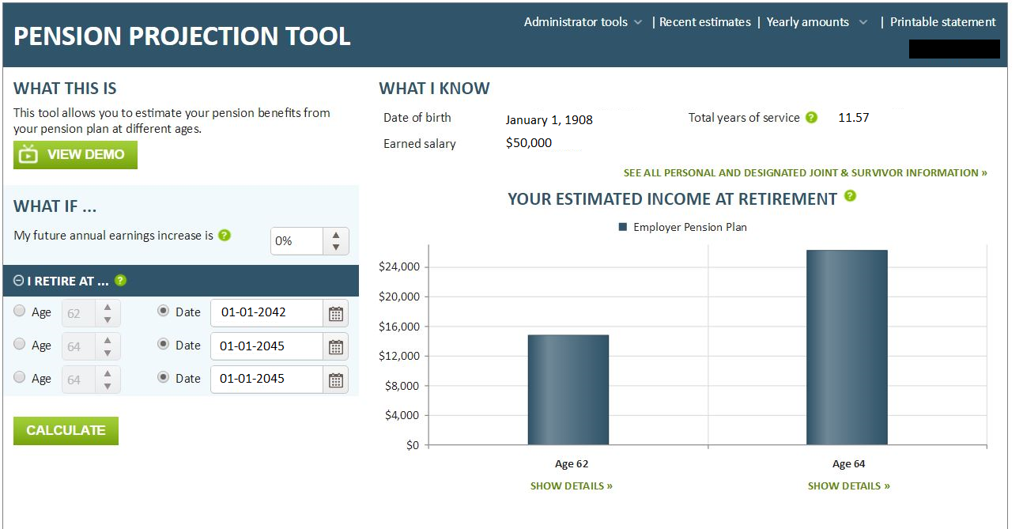
Pension Projection Tool
Access Pension Projection Tool to get retirement eligibility dates and estimated income at retirement!*
*Please note – the figures within the Pension Projection Tool are estimated based on the data reported by your employer. Be sure to read and agree to the disclaimer.

Slide 15

401(a) Plan – Defined Contribution Plan

Slide 16
What is a defined contribution (401a) plan?
The Defined Contribution (DC Plan) allows you to save money for your retirement in a tax-deferred account.
You and your employer contribute a percentage of your salary each pay period into your DC plan that is managed by TIAA.
TIAA manages your investments and when you retire you will withdraw money from this account to pay for your living expenses.

Slide 17
Participation
Existing employees who were working at the time began making contributions to the 401(a) on July 1, 2012
All new employees immediately begin making contributions to this plan as long as they work 20 or more hours per week.
Employees who had 20+ years of service with the State on June 30, 2012 stopped contributing to the 401(a) on June 30, 2015
Contributions made from July 1, 2012-June 30, 2015 are owned by the member, but must stay in the 401(a) until the employee terminates employment

Slide 18
Vesting in the 401(a)
Municipal employees contribute 5% of their pre-tax pay to the 401(a)
Vesting in these contributions is immediate, meaning that whenever you leave state employment you can utilize these funds.
The City contributes to each members 401(a) based on Years of Service at June 30, 2012:
Less than 10 YOS – 1% of pre-tax pay
10 but less than 15 YOS – 1.25% of pre-tax pay
15 but less than 20 YOS – 1.5% of pre-tax pay
Employer contributions vest after 3 years, meaning if you leave service before you have worked for three years, you forfeit these contributions.

Slide 19
Managing your account
Register your account online at TIAA.org/ri
With Single Sign-on, once you have set up your account with TIAA you can login to your pension account, link on the TIAA icon, and get immediately to your 401(a) without having to sign into both.
The site allows you to:
Review and update your personal information
Check account balances and confirm contributions
Update your beneficiary designation – it needs to be changed separately from your Pension Plan
Change the investment of future contributions
Transfer assets among plan investment options
Choose eDelivery

Slide 20
Leaving Municipal service
When you sever employment, you have options with your account balance:
Leave it in the Defined Contribution Retirement Plan
Roll it to your new employer’s retirement plan or to an IRA
Retirees can begin systematic withdrawals for income
Request a full cash withdrawal
You should not take contributions from a retirement account before you are eligible to retire!

Slide 21
Financial Advice/ Planning
Investment advice in person, via phone
or online
To schedule your session,
call John Cislo at 401-276-3746
or e-mail John.Cislo@tiaa.org.
Or, call 800-897-1026, weekdays, 8 a.m. to 10 p.m. or Saturdays, 9 a.m. to 6 p.m. (ET).
Online Advice and Education at TIAA.org/ri
4 simple steps to directly address your goals and financial situation
Quickly update your account

Slide 22
Retirement Planning Checklist
One or More Years Before Retirement
Log into your account at ERSRI.org to update personal information and run a benefit estimate. If you question any information, reach out to ERSRI for a Salary Verification Form
Contact TIAA to meet with a financial planner to discuss your withdrawal options for your DC plan
Six to Nine Months Before Retirement
Contact ERSRI to schedule an appointment for a group retirement workshop
You will receive your benefit estimate and all paperwork necessary to retire

Slide 23
Retirement Planning Checklist
Two to Three Months Before Retirement
Notify your employer of your intention to retire and provide them with the Employers’ Certification of Retirement form, which you will receive at your ERSRI Retirement Workshop. This form must be completed and returned to ERSRI by your employer. ERSRI cannot begin processing your pension benefit until we receive this form. Please make sure your employer returns the form to ERSRI when you terminate employment
Prior to Your Termination Date
Review the “How to Complete Your Retirement Paperwork; contact ERSRI with questions
Complete and return the Required Retirement Paperwork to ERSRI prior to terminating employment.

Slide 24
Death Benefits
What benefits are your survivors entitled to?
A member’s designated beneficiary is eligible to receive a one time death benefit payment regardless of retirement option selected.
Benefit is $800 per year of completed service, up to a maximum benefit of $16,000 with 20 years of service.
Benefit reduces 25% each year of retirement to a minimum death benefit of $4,000.
Please be sure to keep your beneficiary information up to date with ERSRI.

Slide 25

Consider saving more
Your employer offers a Deferred Compensation Plan which offers:
Convenient payroll deductions
Pretax savings to reduce your current taxable income
Tax-deferred growth on your earnings
A convenient way to bolster your retirement income!
To Contact your Vendors:
Voya
John S McMahon CLU, ChFC
Phone: 401-739-5551
E-mail: John.mchahon@voyafa.com
Empower
Jan Richardson, CRPC
Phone: 888-803-2721, x20086
Cell: 508-723-2504

Slide 26
Financial Wellness
To help improve your financial wellness, the State offers the following resources—ranging from in-person fairs and workshops to online tools—all at no additional cost to you:
General Resources and Webinars from our 401(a) provider

Slide 27
Resources
ERSRI Handbook
Pension Forms
TIAA 401(a) Website

Slide 28

Important Contact Information
Employees’ Retirement System of Rhode Island (ERSRI)
50 Service Avenue, 2nd Floor, Warwick, RI 02886
(401) 462-7600
www.ersri.org
TIAA - DC Plan Coordinator
The Gateway Center
15 Park Row West, Suite 102
Providence, RI 02903
(800) 897-1026
www.tiaa.org/ri
Federal Social Security
Providence Office
(877) 402-0808
www.ssa.gov

