Slide 1

PAWTUCKET SCHOOL DEPARTMENT
Slater Middle School Redesign
Community Advisory Board Meeting
3/4/2026
Superintendent: Randy Buck

Slide 2

Welcome Back
Quick Warm-Up:
Biggest redesign wondering on your mind today
Community Advisory Board Meeting

Slide 3
Objectives
Ensure CAB has shared understanding of application progress
Align on the most pressing priority areas
Develop multiple hypothesized root causes for each area
Prioritize 1–2 validated critical root causes per priority
Community Advisory Board Meeting
Notes:
Thank them for completing the pre-work
Reiterate the goal: “Today is an opportunity to dig deeper into the most salient priorities and identify the most critical root causes.”

Slide 4
Today’s Grounding Question
What system conditions are most responsible for why this priority emerged and continues to persist?
If we could change only one or two things in our system to dramatically improve this outcome, what would they be?
Community Advisory Board Meeting
Notes:
Want to ensure that we have a shared data-driven fact base informing our choices
As a team, we’ll work to agree on the priorities (based on your pre-work) and identify the most prevalent root causes
Clarify that the goal is narrowing, not brainstorming endlessly. Last time we were generative, this time we must hone in.
The rootiest cause will ensure we’re solving the problem with the best leverage for impact and the ones we can actually influence.
It will be critical today to focus on what is within our locus of control.
We must push from “what” to “WHY” today.

Slide 5
CAB Norms
Students at the Center: We ground all discussions and recommendations in what best serves students and their long-term success.
Listen to Understand: We practice active listening, seek to understand different perspectives, and make space for all voices.
Share the Air: We balance speaking and listening, stepping up or stepping back or calling in so everyone can contribute.
Be Present and Engaged: We come to meetings on time, focused, and ready to engage with materials and each other.
Respectful Dialogue: We assume positive intent, engage in honest conversation, and disagree with ideas, not people.
Equity and Community: We intentionally consider the impact of redesign ideas on diverse student groups and elevate perspectives from the broader community.
Notes:
Ask everyone to commit to one norm they want to keep top of mind today.

Slide 6

Redesign Update
New early application draft deadline for RIDE’s review, submitted February 13, initial feedback was VERY positive!
Broader stakeholder engagement opportunities
Communication efforts
March 20th final application deadline
Focus area of CTE named
Community Advisory Board Meeting
Notes:
Goal: Ensure transparent updates are being shared with the CAB while also reinforcing their input is still critical/valuable and is being included.
Key Points:
Initial draft of portions sent for feedback to RIDE (kudos to the team, the needs assessment is being used as a model for other districts!)
Application Deadline of March 20th
Broader stakeholder engagement opportunities: focus groups, stakeholder surveys, school CSIT
Communication (website creation, social media updates)
Focus area of CTE
Some messaging ideas:
I want to be transparent that we were required to submit an initial portion of the application, including a draft root cause analysis, for early review.
That submission was based on the priority areas and themes this group has already identified in previous meetings and in your pre-work reflections.
What we submitted was an early draft for feedback, not a final determination. The purpose was to receive state input before full submission so we can strengthen the final plan.
Today’s session is our opportunity to stress-test, refine, and, if needed, revise those draft root causes to ensure they truly reflect our analysis and will guide strong initiatives. Your input, thus, is still central to those root cause determinations.
Strong redesign work is iterative. We drafted under deadline; now we strengthen it together. Our goal is to ensure the final submission reflects our best analysis.

Slide 7
Priority Problem Areas
Family/Community Engagement
Persistent Low Performance and Growth in Math and ELA
(and even lower performing subgroups)
Attendance Rates (Teacher and Students)
Community Advisory Board Meeting
Notes:
Name that these priority areas are informed most predominantly by their post-work from the survey in the last session and the conversation we had as a group. They have also been informed/shaped by broader stakeholder engagement/feedback collected thus far (building leadership, district leadership, CSIT, etc.). Because there was alignment between us and others, these were included in our early draft for feedback.
Today we’ll be digging into each of these priory areas to determine the root causes for WHY these problems persist.

Slide 8
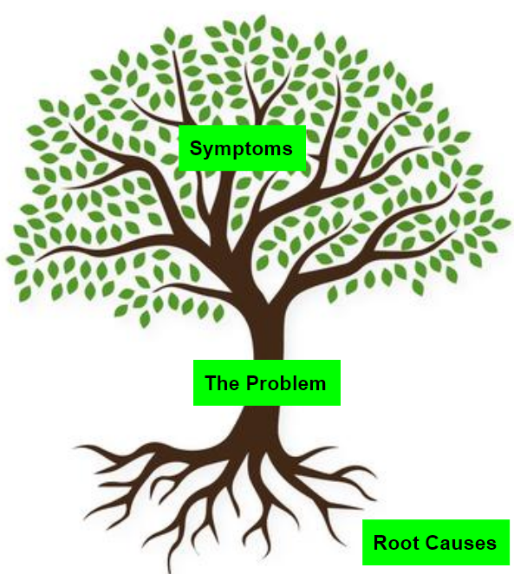
Defining “Root Cause”
A critical root cause:
Is systemic (not isolated)
Is within school/district control to address
Explains the problem over time/why it persists
If addressed, would significantly improve outcomes
Community Advisory Board Meeting
Notes:
A root cause is a systemic adult practice, structure, or condition within the school’s control that explains why a problem exists and persists over time, and that, if addressed, would significantly improve outcomes.

Slide 9
Defining “Root Cause”
A root cause is not….
A symptom (e.g., low test scores, absenteeism)
A student deficit (e.g., “students lack motivation”)
A broad external factor (e.g., poverty, community issues)
A solution disguised as a cause (e.g., “we need more PD”)
Community Advisory Board Meeting
Notes:
Way to test:
If we fixed this, would the problem likely improve?
Does this explain why the issue persists year after year?
Is this something we can influence or change?
If the answer is yes to all three, you likely have a root cause.

Slide 10
Small Group Root Cause Sprint
Quick Individual Reflection/Pre-Work Refresh (2 mins)
Discussion and Note Taking (10 minutes)
  Ask “Why?” at least 5 times
  Record causes, eliminating any that are not adult/system-based or within the locus of control
Ruthless Prioritization: Choose the 1-2 most critical root causes ONLY (8 minutes)
  If we could only fix ONE thing related to this priority, what would give us the greatest impact?
**Pick a notetaker and a reporter before you begin.
Community Advisory Board Meeting
Notes:
*remind everyone to avoid “solutionitis”- we are not determining HOW these root causes will be addressed, rather we need to identify the “why” behind outcomes first so then we can figure out the strategy to address it.
**this is your opportunity to share your pre-work thinking
Explain how the time will work:
Small Group Brainstorm Sprints
Select Note-taker and reporter before you begin
Individual Reflection (3 mins)
Why has this persisted year after year?
What adult practice or system condition is most likely driving this?
Why didn’t previous improvement efforts fix it?
Discussion and Note Taking (10 minutes per problem)
Start with the priority problem
Ask “Why?” at least 5 times
Record causes, eliminating any that are not adult/system-based or within the locus of control
Ruthless Prioritization: Choose the 1-2 most critical root causes ONLY
If we could only fix ONE thing related to this priority, what would give us the greatest impact?
Direct everyone to the note taking document (put in the chat) which has guiding prompts in it.
Notetaker: https://docs.google.com/document/d/19pYhcgjlr86bFsbzTvfxFUZ8dnaGD1lUle8t0qJjgg8/edit?tab=t.0

Slide 11

The Ultimate Goal: “Rootiest” Cause
The Why Protocol…..
Repeatedly ask “why is this happening” for each generated cause
Each answer becomes the basis for the next “why”
Our goal is not to land on five answers, it’s to go deep enough to uncover a systemic, adult-controlled root cause.
Community Advisory Board Meeting
Notes:
Quick deep dive into how the why protocol will work.
The 5 Whys is a simple root cause analysis method that helps teams move from surface-level explanations to deeper systemic causes.
It works by repeatedly asking: “Why is this happening?”
Each answer becomes the basis for the next “why,” pushing the team beyond symptoms and toward underlying system conditions. Our goal is not to land on five answers — it’s to go deep enough to uncover a systemic, adult-controlled root cause.
Release the groups to break-outs, 2-3 per group
Notetaker: https://docs.google.com/document/d/19pYhcgjlr86bFsbzTvfxFUZ8dnaGD1lUle8t0qJjgg8/edit?tab=t.0

Slide 12
Small Group Work Time
Notetaker:
https://docs.google.com/document/d/19pYhcgjlr86bFsbzTvfxFUZ8dnaGD1lUle8t0qJjgg8/edit?tab=t.0
Community Advisory Board Meeting
Notes:
Release the groups to break-outs, 2-3 per group
Notetaker: https://docs.google.com/document/d/19pYhcgjlr86bFsbzTvfxFUZ8dnaGD1lUle8t0qJjgg8/edit?tab=t.0

Slide 13

Small Group Discussion: Critical RCs
Pressure Testing
Does this feel within our locus of control? Highest leverage?
Does this drive/impact other root causes?
Does the data corroborate it?
If we address this, would outcomes likely change?
Community Advisory Board Meeting
Notes:
Time: 20 minutes
Key Points
Ask reporters from each small group to share out key take-aways and chosen 1-2 critical root causes to address
Ask the group to be prepared to be critical friends and pressure test the analysis- is this the right critical root cause? why/why not?
Ask everyone to consider:
Does this feel within our locus of control? Highest leverage?
Does this drive/impact other root causes?
Does the data corroborate it?
If we address this, would outcomes likely change?
Drive consensus when possible. Surface tensions or disagreements that will need to be further considered. Welcome amendments or refinements as feedback is given.

Slide 14
Discussion Notes
Notes:
Notes:
Notes:
As the group discusses, list out the critical root causes so people can visibly see them all together. Made real time adjustments as needed.

Slide 15

Are we aligned?
On a scale of 1-10 (10 = 100% agree, 1= do not agree at all), how strongly do you agree with the critical root causes we’ve landed on today?
Put your number in the chat.
Community Advisory Board Meeting
Notes:
Ask everyone to press enter at the same time to prevent group think.
If time permits, invite explanation, particularly if there are big disagreements.

Slide 16
Closing
Closing Whip Around: What is one affirmation you have for the group or a fellow CAB member today?
Next meeting will focus on input on proposed solutions and strategies to address critical causes
Next meeting date
Notes:
Closing whip around
Today’s conversation affirmed the draft thinking already shared in our redesign plan as well as will provide additional evidence and insights to strengthen the thinking
Now that we’ve defined the most critical root causes, we’ll be turning our attention to your input on some proposed solutions to these causes

